Slide 1
Enhanced DTF-AT
For Audio Event Classification
Parth Bhalerao · Haiyan Liao · David Chou · Dhanishtha Patil

Slide 2
THE CHALLENGE
Why is Audio Classification Hard?
Standard CNNs Fall Short
Effective at local features but miss global context. Cannot model long-range temporal dependencies across a 10-second clip.
A 10-second clip can contain multiple overlapping events across different frequency ranges. Standard models fail to jointly capture fine-grained spectral detail and long-range temporal structure.
Vision Transformers Are Naïve
527
Treat spectrograms as flat 2D images, ignoring the distinct physical properties of time and frequency axes in audio signals.
Audio event classes in AudioSet
Multi-Label Complexity
Overlapping events with 2–3 average labels per clip demand precise multi-label reasoning with independent class probabilities.
Transfer Learning Tension
ImageNet pretrained weights come from a visual domain. Bridging them to audio requires extremely careful optimization strategies.

Slide 3
AUDIOSET BALANCED SUBSET
Dataset at a Glance
20,550
18,886
527
10s
32kHz
~22 GB
TRAINING CLIPS
EVAL CLIPS
EVENT CLASSES
CLIP DURATION
SAMPLE RATE
TOTAL SIZE
We train and evaluate on the AudioSet Balanced subset, which provides a representative cross-section of the full 527-class ontology with carefully verified human labels.

Slide 4
THE CORE PROBLEM
Gradient Instability
STAGE 1 — FREEZE (EPOCHS 1–10)
Pretrained backbone frozen. Only new randomly initialised components receive updates. They stabilise and learn basic data features without disrupting the backbone.
A fundamental conflict arises when combining randomly initialised components with well-tuned ImageNet pretrained weights in the same training pass.
↓
Randomly initialised layers produce large unstable gradients in early training that corrupt the pretrained backbone before new components can stabilise, causing catastrophic performance loss.
STAGE 2 — JOINT TRAINING (EPOCHS 11–50)
Full network unfrozen. All components train together. New layers now provide stable gradients that cooperate with the pretrained representations rather than destroying them.
Two-Stage Training Strategy
↓
Stage 1 — Freeze the pretrained backbone for 10 epochs. New components learn the data distribution without corrupting pretrained weights.
Stage 2 — Unfreeze everything for 40 epochs of full joint fine-tuning from a stable initialization.
OUTCOME
Attention Pooling: 0.13 → 0.30 mAP | All Combined: 0.21 → 0.31 mAP

Slide 5
BASELINE
Original DTF-AT
Processes spectrograms through parallel time and frequency paths before integrating them via self-attention across four hierarchical stages in a 2-2-5-2 configuration.
01
Dual Convolutional Stem — Parallel Conv-F and Conv-T paths blended via a learned scalar alpha, capturing both time and frequency local structure.
02
2-2-5-2 Stage Configuration — Four hierarchical encoder stages with channel depth growing from 64 to 96, 192, 384, and 768.
03
Window and Grid Attention — Local windowed attention for fine texture; global grid attention for long-range dependencies in every block.
04
32 × 4 Final Representation — Input compressed from 1024 × 128 to 32 frequency by 4 time bins before classification over 527 classes.
05
ImageNet-1K Initialisation — Cross-domain transfer learning from visual to audio domain following the original paper protocol.

Slide 6
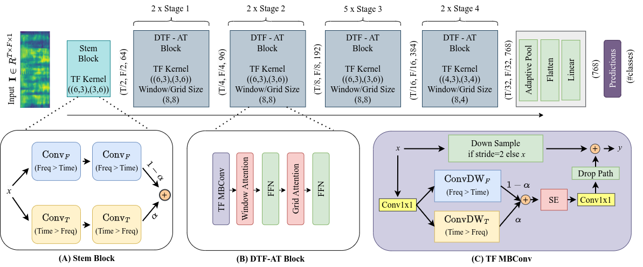
BASELINE
Original Architecture
0.267
0.278
−0.01
Our Result (3 seeds)
Paper Reports
Reproduction Gap

Slide 7
ENHANCEMENT 1 OF 4
Hybrid Pre-Stem
A residual convolutional block inserted before the standard transformer stem to extract low-level spectro-temporal features that patch-based attention cannot capture on its own.
01
Residual CNN Block — Two 3×3 convolutions with BatchNorm and ReLU, combined with a skip connection that preserves the original input signal.
02
Shape-Preserving Design — Output shape (T, F, 1) identical to input, making it fully compatible with the downstream pretrained stem block without any modification.
03
Low-Level Feature Extraction — Captures harmonic textures, note onsets, and spectral edges that transformers miss in early patch embeddings.
04
Minimal Gradient Conflict — The residual connection ensures the original passes through unchanged even before conv layers stabilize, protecting pretrained weights
05
Best Overall Result — Achieved 0.34 mAP single-stage and 0.35 mAP with two-stage training — the strongest result across all tested configurations.

Slide 8
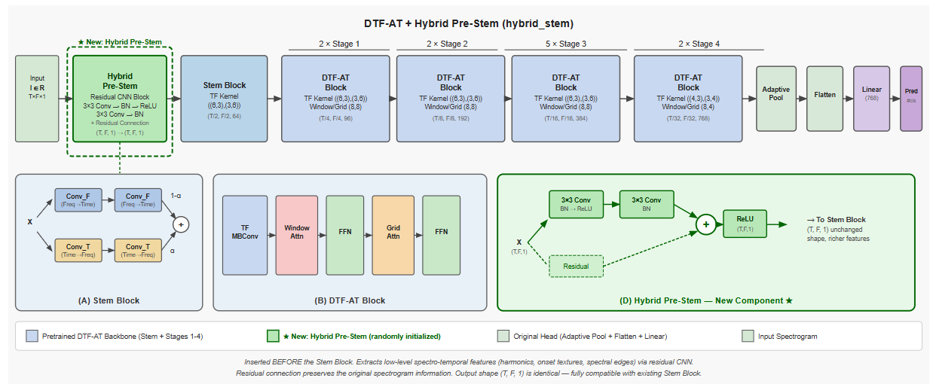
HYBRID PRE-STEM
Best Result
0.34
SINGLE STAGE MAP (+0.08)
0.35
TWO STAGE MAP ★ (+0.09)
Gains under both training strategies confirm that enriching low-level features before the transformer stem consistently outperforms adding complexity at the classification head.

Slide 9
ENHANCEMENT 2 OF 4
Attention Pooling Head
Replaces standard adaptive pooling with a learned multi-head attention mechanism that dynamically focuses on the most relevant time-frequency regions for each prediction.
01
Learnable Query Vector — A 768-dimensional trainable query attends over all 32 × 4 spatial positions in the final Stage 4 feature map.
02
Multi-Head Attention — 8 attention heads with head dimension 96, enabling parallel attention over different representation subspaces simultaneously.
03
Dynamic Spatial Focus — Rather than averaging all positions equally, the model learns which time segments and frequency bands matter most per audio class.
04
LayerNorm and MLP — Attended representation refined through layer normalisation and a feedforward block before the linear classifier produces predictions.
05
Severe Gradient Instability — Randomly initialised attention layers disrupted pretrained weights catastrophically in single-stage training, dropping mAP to 0.13.

Slide 10
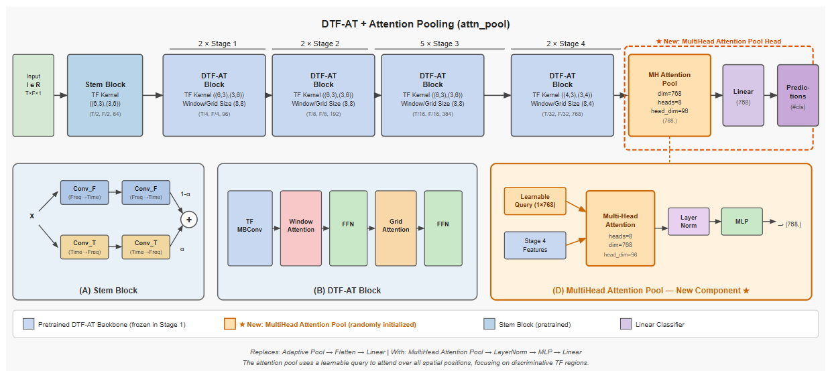
ATTENTION POOLING
Biggest Recovery
0.13
SINGLE STAGE MAP (INSTABILITY)
0.30
TWO STAGE MAP (+0.17 RECOVERY)
The dramatic 0.17 mAP recovery is the strongest evidence that gradient instability is a real and solvable problem through staged optimisation.

Slide 11
ENHANCEMENT 3 OF 4
Multi-Scale Fusion Head
Collects intermediate representations from all four encoder stages and fuses them through cross-attention and a learnable weighted sum to create a richer multi-scale classification feature.
01
All Four Stages Tapped — Stage 1 (96d), Stage 2 (192d), Stage 3 (384d), Stage 4 (768d) each projected to 768-dim via adaptive pooling.
02
Cross-Attention Fusion — Stage 4 acts as query over all four stage tokens, letting high-level semantic features selectively attend to earlier fine-grained details.
03
Learnable Weighted Sum — w1·S1 + w2·S2 + w3·S3 + w4·S4 lets the model dynamically balance contribution from each stage during training.
04
Multi-Scale Representation — Blends fine-grained local textures from early stages with high-level semantic patterns from the final stage.
05
Moderate Instability — New randomly initialised components cause some gradient conflict but less severe than the attention pooling head alone.

Slide 12
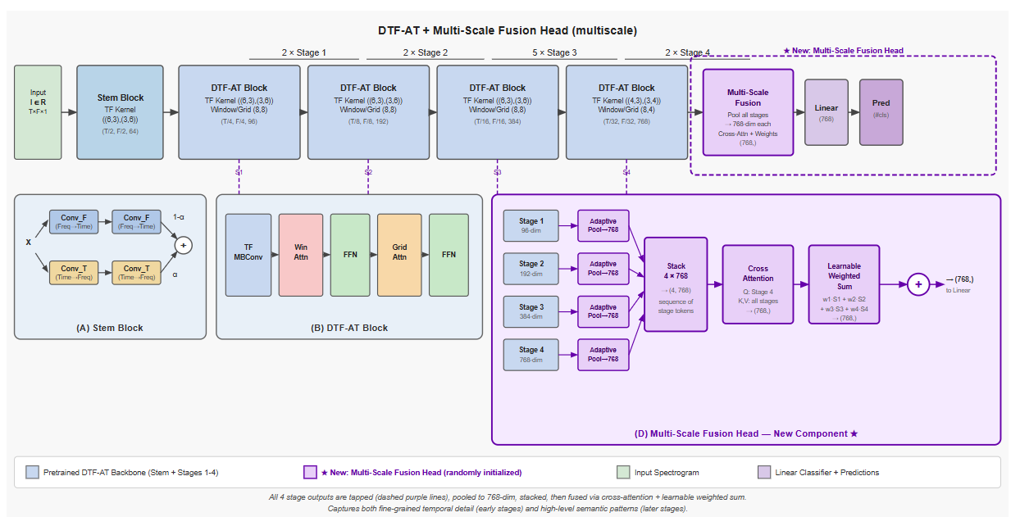
MULTI-SCALE FUSION
Stage-Wise Results
0.29
SINGLE STAGE MAP (+0.03)
0.32
TWO STAGE MAP (+0.06)
Consistent improvement under both strategies confirms that multi-scale feature fusion genuinely benefits audio classification when the optimisation is managed correctly.

Slide 13
ENHANCEMENT 4 OF 4
All Combined
Simultaneously integrates all three architectural modifications into a single unified model to evaluate whether combined enhancements can stack their individual gains.
01
Hybrid Pre-Stem — Residual CNN block at the input for low-level feature enrichment before the transformer stem processes the spectrogram.
02
Multi-Scale Fusion — Cross-attention over all four stage outputs for a rich multi-resolution classification signal from the full encoder hierarchy.
03
MultiHead Attention Pooling — Learnable query attention over Stage 4 features for dynamic spatial focus at the classification head.
04
Summed Outputs — Multi-Scale Fusion and Attention Pooling branches are summed before the final linear classifier produces predictions.
05
Maximum Gradient Conflict — Three randomly initialised components simultaneously fighting the pretrained backbone — the most severe instability case tested.

Slide 14
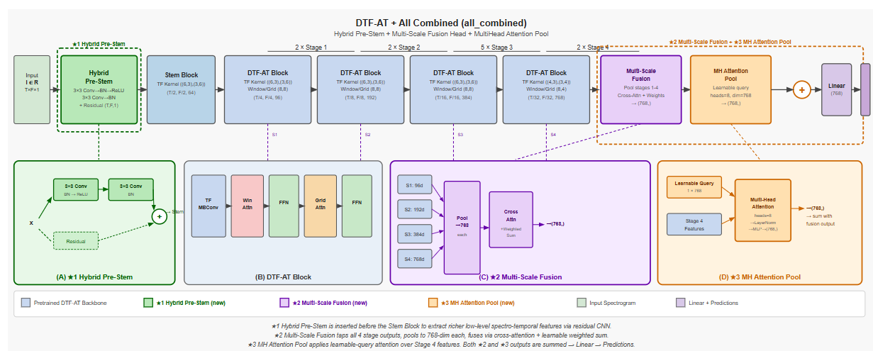
ALL COMBINED
Combined Results
0.21
SINGLE STAGE MAP (3× INSTABILITY)
0.31
TWO STAGE MAP (+0.10 RECOVERY)
Two-stage training recovers the combined model to 0.31 mAP despite maximum instability, demonstrating the strategy works even in the most complex configuration.

Slide 15
ABLATION STUDY
Final Results
Configuration | Single Stage | Two Stage | Gain
Baseline | 0.26 | N/A | —
Time-Reversed Aug | 0.33 | N/A | +0.07
Hybrid Pre-Stem ★ | 0.34 | 0.35 | +0.09
Multi-Scale Fusion | 0.29 | 0.32 | +0.06
Attention Pooling | 0.13 | 0.30 | +0.04
All Combined | 0.21 | 0.31 | +0.05
Spectral over temporal
Time-reversed augmentation proved audio events are defined by frequency content, not temporal order, adding 0.07 mAP with zero architectural changes.
Simple beats complex
The shape-preserving Hybrid Pre-Stem outperformed all configurations by enriching low-level features before the transformer rather than adding head complexity.
Optimisation is architecture
Two-stage training rescued failing configurations dramatically, proving how you train matters as much as what you build.
0.35
Best mAP — Hybrid Pre-Stem with Two-Stage Training
Gradient stability is critical
Any randomly initialised component mixed with a pretrained backbone requires staged optimisation to prevent catastrophic weight corruption.

Slide 16
BIBLIOGRAPHY
References
[1] Alex et al. (2024). DTF-AT: Decoupled Time-Frequency Audio Transformer for Event Classification. AAAI 2024, pp. 17647–17655.
[2] Gemmeke et al. (2017). Audio Set: An ontology and human-labeled dataset for audio events. ICASSP 2017, pp. 776–780.
[3] Gong et al. (2021). AST: Audio Spectrogram Transformer. Interspeech 2021, pp. 571–575.
[4] Kong et al. (2020). PANNs: Large-Scale Pretrained Audio Neural Networks for Audio Pattern Recognition. IEEE/ACM TASLP, 28, 2880–2894.
[5] Liu et al. (2021). Swin Transformer: Hierarchical Vision Transformer Using Shifted Windows. ICCV 2021, pp. 10012–10022.
[6] Tu et al. (2022). MaxViT: Multi-Axis Vision Transformer. ECCV 2022, pp. 459–479.
[7] Loshchilov & Hutter (2019). Decoupled Weight Decay Regularization. ICLR 2019.
[8] Deng et al. (2009). ImageNet: A Large-Scale Hierarchical Image Database. CVPR 2009, pp. 248–255.

Slide 17
Thank You
Questions & Discussion
Parth Bhalerao · Haiyan Liao · David Chou · Dhanishtha Patil

